Slide 1

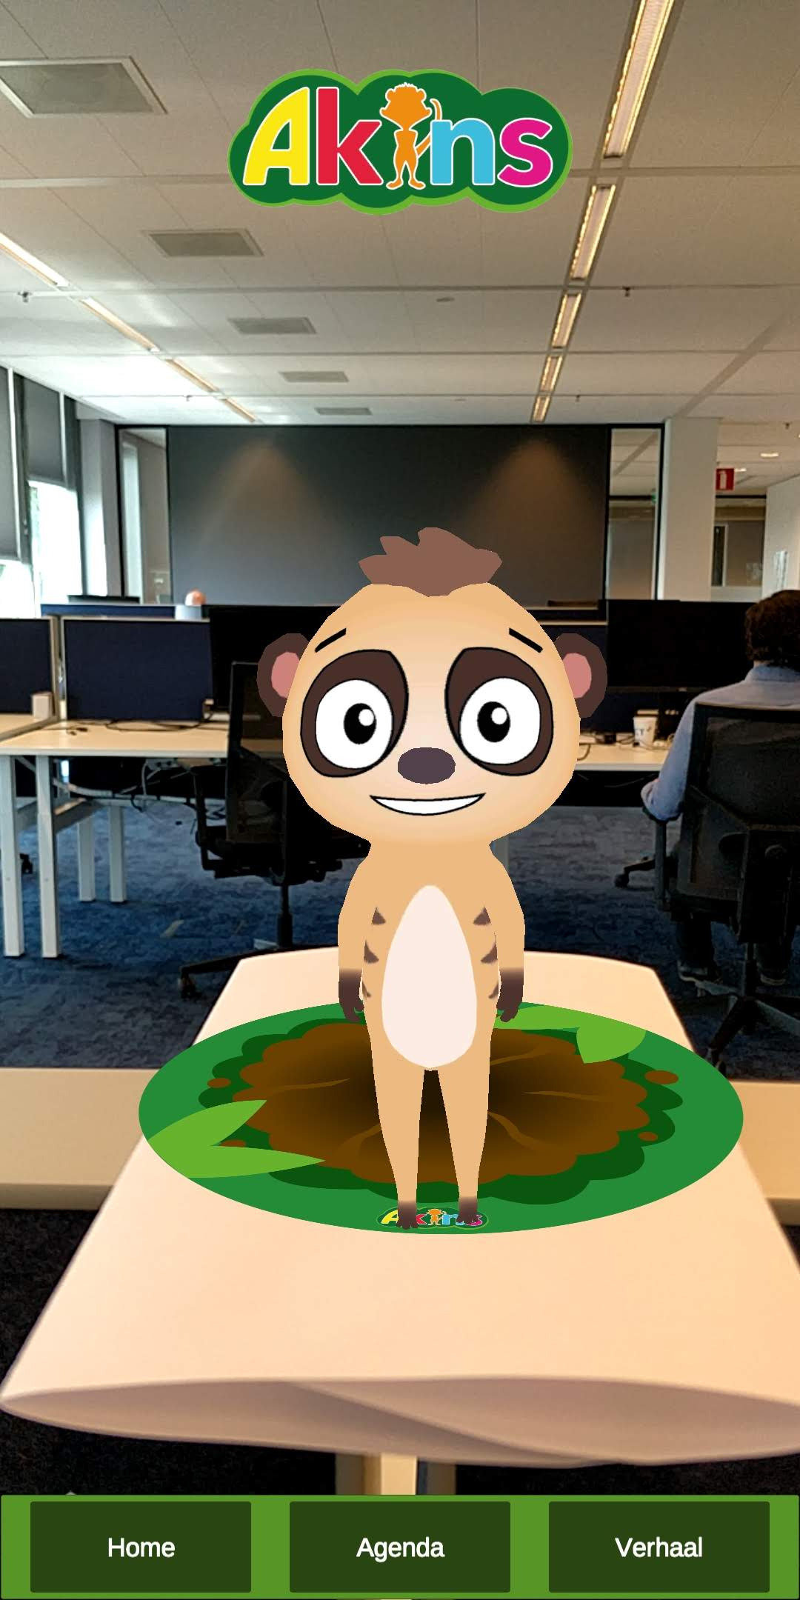



Atkins
AR
For a video demo, please scan the QR code
Going to hospital is not the best experience one can have, especially for young children.
Atkins is an augmented reality animated character to accompany children when they go to hospital to make it less intimidating and more fun.
Atkins welcomes you with a quick introduction about himself once you scan the marker on the wall with your phone.
He can also tell you some stories and play games while you’re waiting for your appointment.
The app is developed for android device.
This project is a collaboration between CoLab and
Nik ter Beek (Nik_terBeek@hotmail.com)
Jimmy Sieben (jummyjohnsieben@gmail.com)

